Slide 1

Chapter 17: Linked Lists
Copyright © 2009 Pearson Education, Inc. Publishing as Pearson Addison-Wesley

Slide 2
17.1
Introduction to the Linked List ADT

Slide 3
Introduction to the Linked List ADT
Linked list: set of data structures (nodes) that contain references to other data structures
NULL
list
head

Slide 4
Introduction to the Linked List ADT
References may be addresses or array indices
Data structures can be added to or removed from the linked list during execution
newNode
list
head
NULL

Slide 5
Linked Lists vs. Arrays and Vectors
Linked lists can grow and shrink as needed, unlike arrays, which have a fixed size
Linked lists can insert a node between other nodes easily
NULL
list
head

Slide 6
Node Organization
A node contains:
data: one or more data fields – may be organized as structure, object, etc.
a pointer that can point to another node
pointer
data

Slide 7
Linked List Organization
Linked list contains 0 or more nodes:
Has a list head to point to first node
Last node points to NULL
NULL
list
head

Slide 8
Empty List
If a list currently contains 0 nodes, it is the empty list
In this case the list head points to NULL
list
head
NULL

Slide 9
Declaring a Node
Declare a node:
struct ListNode
{
int data;
ListNode *next;
};
No memory is allocated at this time

Slide 10
Defining a Linked List
Define a pointer for the head of the list:
ListNode *head = NULL;
Head pointer initialized to NULL to indicate an empty list
head
NULL

Slide 11
NULL Pointer
Is used to indicate end-of-list
Should always be tested for before using a pointer:
ListNode *p;
while (p != NULL) ...
Can also test the pointer itself:
while (!p) ... // same meaning
// as above

Slide 12
17.2
Linked List Operations

Slide 13
Linked List Operations
Basic operations:
append a node to the end of the list
insert a node within the list
traverse the linked list
delete a node
delete/destroy the list

Slide 14
Contents of NumberList.h
1 // Specification file for the NumberList class 2 #ifndef NUMBERLIST_H 3 #define NUMBERLIST_H 4 5 class NumberList 6 { 7 private: 8 // Declare a structure for the list 9 struct ListNode 10 { 11 double value; // The value in this node 12 struct ListNode *next; // To point to the next node 13 }; 14 15 ListNode *head; // List head pointer 16

Slide 15

Contents of NumberList.h (Continued)
17 public: 18 // Constructor 19 NumberList() 20 { head = NULL; } 21 22 // Destructor 23 ~NumberList(); 24 25 // Linked list operations 26 void appendNode(double); 27 void insertNode(double); 28 void deleteNode(double); 29 void displayList() const; 30 }; 31 #endif

Slide 16
Create a New Node
newNode
Allocate memory for the new node:
newNode = new ListNode;
Initialize the contents of the node:
newNode->value = num;
Set the pointer field to NULL:
newNode->next = NULL;
newNode
23
newNode
23
NULL

Slide 17
Appending a Node
Add a node to the end of the list
Basic process:
Create the new node (as already described)
Add node to the end of the list:
If list is empty, set head pointer to this node
Else,
traverse the list to the end
set pointer of last node to point to new node

Slide 18
Appending a Node
nodePtr
5
13
19
NULL
list
head
23
NULL
newNode
New node created, end of list located

Slide 19
Appending a Node
nodePtr
5
13
19
list
head
23
NULL
newNode
New node added to end of list

Slide 20
C++ code for Appending a Node
11 void NumberList::appendNode(double num) 12 { 13 ListNode *newNode; // To point to a new node 14 ListNode *nodePtr; // To move through the list 15 16 // Allocate a new node and store num there. 17 newNode = new ListNode; 18 newNode->value = num; 19 newNode->next = NULL; 20 21 // If there are no nodes in the list 22 // make newNode the first node. 23 if (!head)

Slide 21
C++ code for Appending a Node (Continued)
24 head = newNode; 25 else // Otherwise, insert newNode at end. 26 { 27 // Initialize nodePtr to head of list. 28 nodePtr = head; 29 30 // Find the last node in the list. 31 while (nodePtr->next) 32 nodePtr = nodePtr->next; 33 34 // Insert newNode as the last node. 35 nodePtr->next = newNode; 36 } 37 }

Slide 22
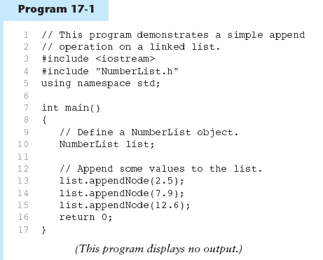

Slide 23
Inserting a Node into a Linked List
Used to maintain a linked list in order
Requires two pointers to traverse the list:
pointer to locate the node with data value greater than that of node to be inserted
pointer to 'trail behind' one node, to point to node before point of insertion
New node is inserted between the nodes pointed at by these pointers

Slide 24
Inserting a Node into a Linked List
previousNode
nodePtr
5
13
19
NULL
list
head
17
NULL
newNode
New node created, correct position located

Slide 25
Inserting a Node into a Linked List
previousNode
nodePtr
5
13
19
NULL
list
head
17
newNode
New node inserted in order in the linked list

Slide 26
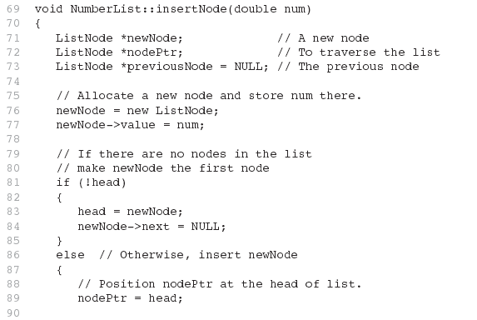

Slide 27
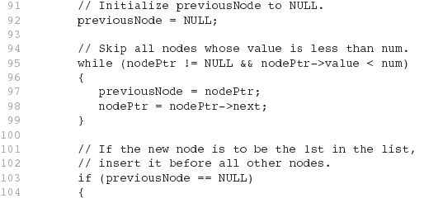

Slide 28
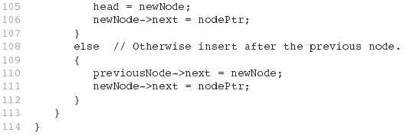

Slide 29
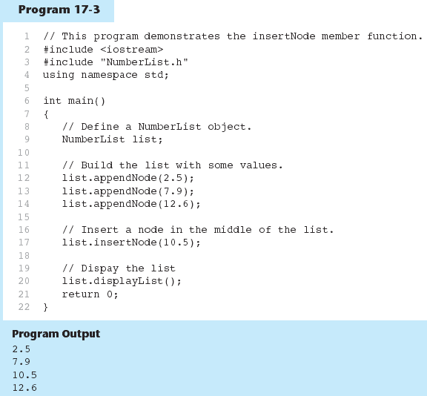

Slide 30
Traversing a Linked List
Visit each node in a linked list: display contents, validate data, etc.
Basic process:
set a pointer to the contents of the head pointer
while pointer is not NULL
process data
go to the next node by setting the pointer to the pointer field of the current node in the list
end while

Slide 31
Traversing a Linked List
nodePtr
5
13
19
NULL
list
head
nodePtr points to the node containing 5, then the
node containing 13, then the node containing 19,
then points to NULL, and the list traversal stops

Slide 32
Deleting a Node
Used to remove a node from a linked list
If list uses dynamic memory, then delete node from memory
Requires two pointers: one to locate the node to be deleted, one to point to the node before the node to be deleted

Slide 33
Deleting a Node
previousNode
nodePtr
5
13
19
NULL
list
head
Locating the node containing 13

Slide 34
Deleting a Node
previousNode
nodePtr
5
13
19
NULL
list
head
Adjusting pointer around the node to be deleted

Slide 35
Deleting a Node
previousNode
nodePtr
5
19
NULL
list
head
Linked list after deleting the node containing 13

Slide 36
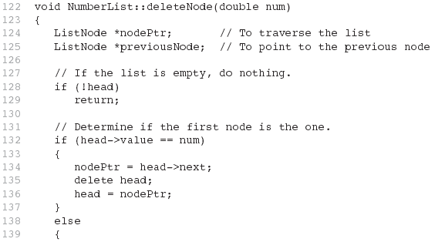

Slide 37
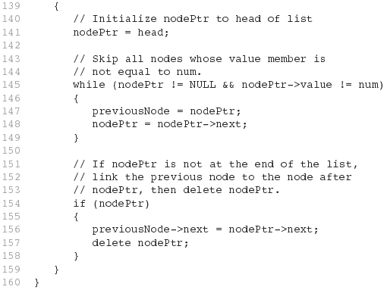

Slide 38
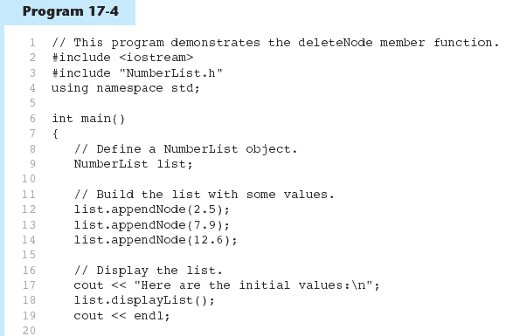

Slide 39
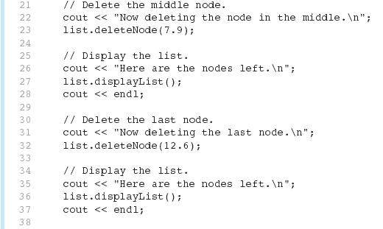

Slide 40
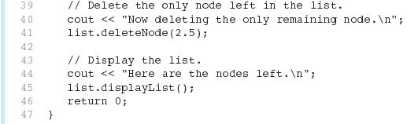
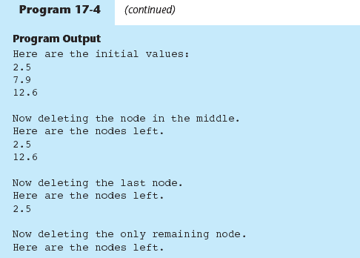

Slide 41
Destroying a Linked List
Must remove all nodes used in the list
To do this, use list traversal to visit each node
For each node,
Unlink the node from the list
If the list uses dynamic memory, then free the node’s memory
Set the list head to NULL

Slide 42
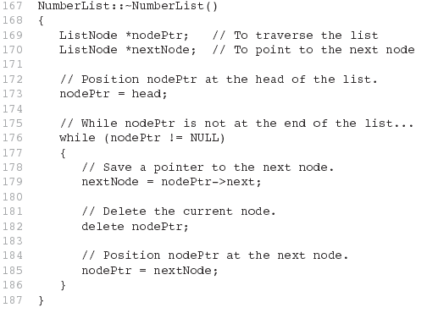

Slide 43
17.3
A Linked List Template

Slide 44
A Linked List Template
When declaring a linked list, must specify the type of data to be held in each node
Using templates, can declare a linked list that can hold data type determined at list definition time
See LinkedList.h (versions 1 and 2) and Program 17-5

Slide 45
17.4
Variations of the Linked List

Slide 46
Variations of the Linked List
Other linked list organizations:
doubly-linked list: each node contains two pointers: one to the next node in the list, one to the previous node in the list
5
13
19
NULL
list
head
NULL

Slide 47
Variations of the Linked List
Other linked list organizations:
circular linked list: the last node in the list points back to the first node in the list, not to NULL
5
13
19
list
head

Slide 48
17.5
The STL list Container

Slide 49
The STL list Container
Template for a doubly linked list
Member functions for
locating beginning, end of list: front, back, end
adding elements to the list: insert, merge, push_back, push_front
removing elements from the list: erase, pop_back, pop_front, unique
See Table 17-1 for a list of member functions

